Slide 1
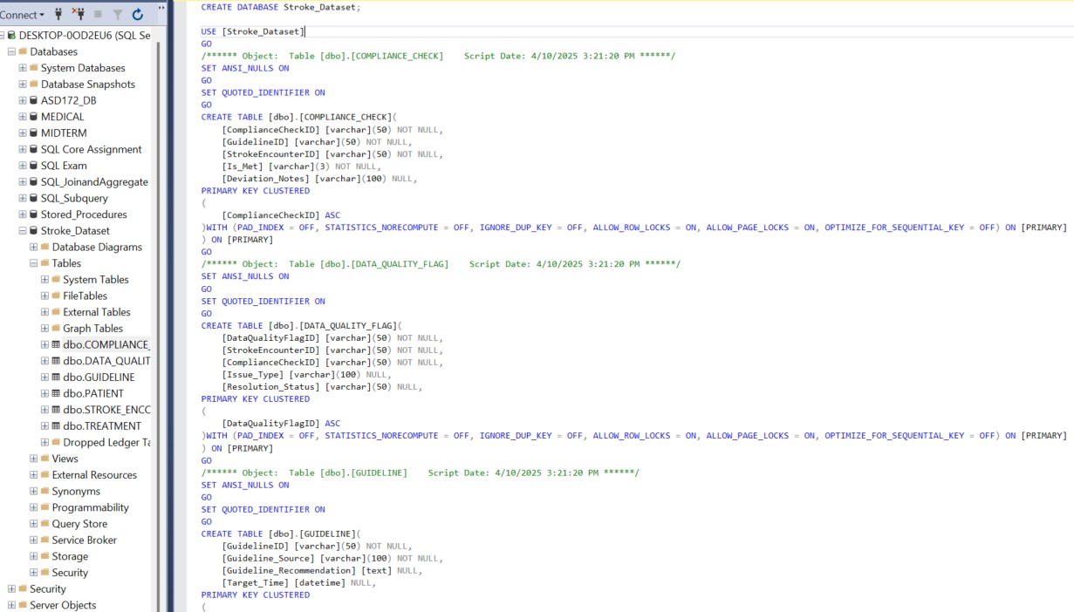
Design: SSMS (HOW)
Process begins in SQL Server Management Studio, where structure is implemented.
SQL Script (868 pages) forms the foundation where all clinical and compliance data for OHMC will be stored securely

Slide 2
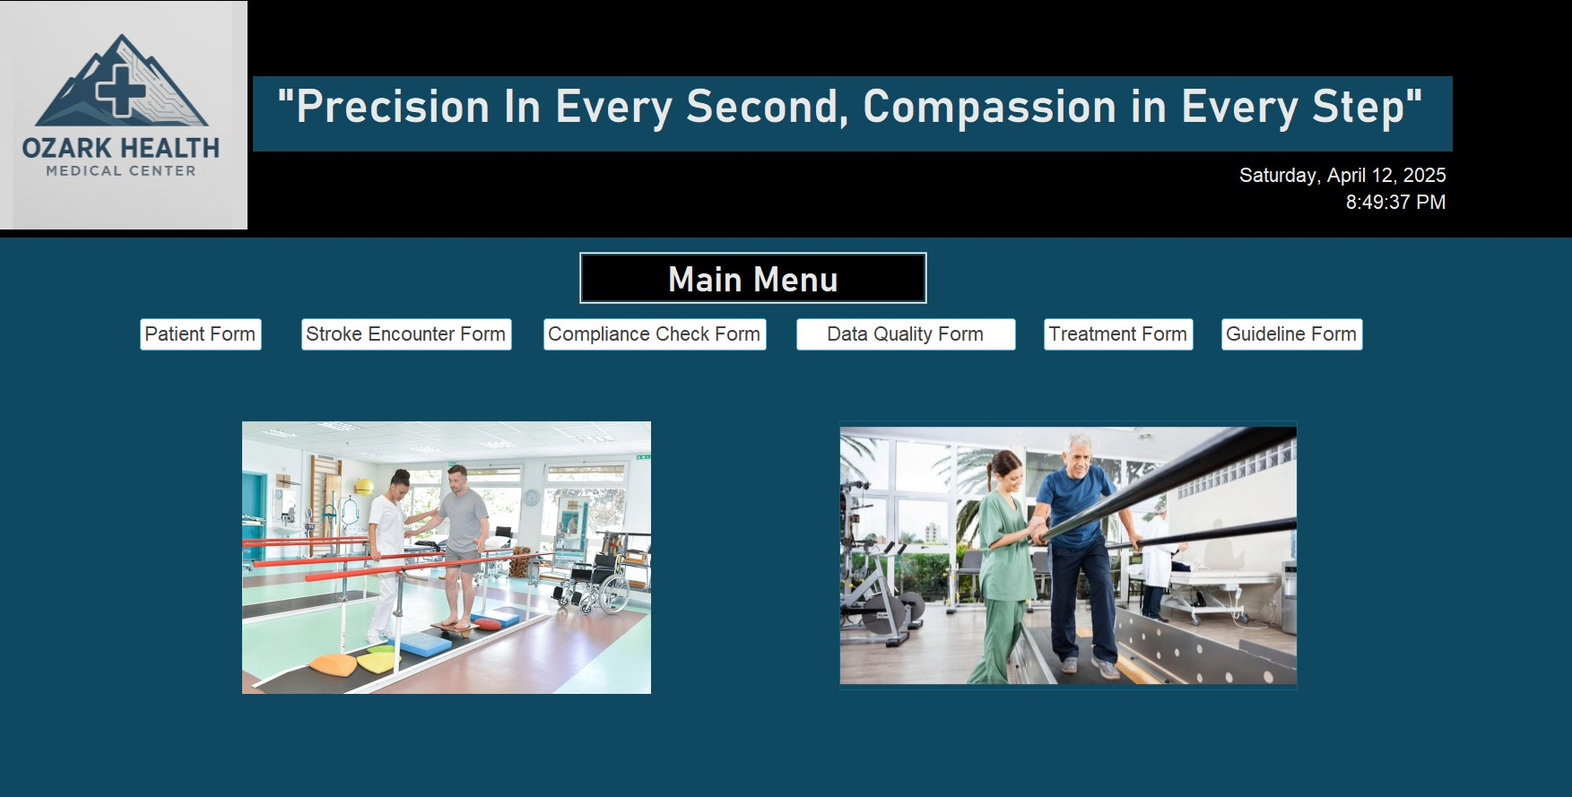
Design: Ms access (HOW)
Click here to fill out Patient Form

Slide 3
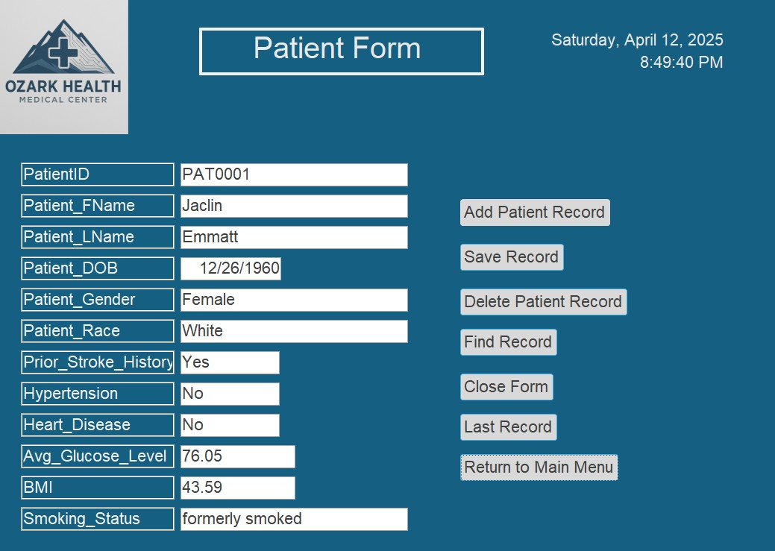
Design: Ms access (HOW)
One example of 6 forms including the Main Menu
Create (“Add Patient Record”
Read (“Find Record”)
Update (any fields)
Delete (“Delete Patient Record”)

Slide 4
MS Access Link:
https://1drv.ms/u/c/0867b5d0b17ac515/Ecavm875KMNFhVwUQcftWRcBUWjDhr1bcGejNlsqo9sWVg?e=m6q6PU

